Slide 1


1
FULL PROJECT ID: SWEM-36
Grow wise: The Crop Predictor
GROUP MEMBERS:
Abdul Kabeer ROLL#. 2K20/SWE/6
Muhammad Bilal Raza ROLL#. 2K20/SWE/61
Mukhtyar khan ROLL#. 2K20/SWE/74
SUPERVISOR NAME:
DR. Mumtaz Qubolio
DEPARTMENT OF SOFTWARE ENGINEERING,
FACULTY OF ENGINEERING AND TECHNOLOGY,
UNIVERSITY OF SINDH, JAMSHORO

Slide 2
2
Contents
Introduction of Project
Literature Review / Similar Projects
Problem Identification/ Statement
Aim and Objectives
Scope of Project
Project Milestones and Deliverables
Tools and Technologies
Design and Development Methodology
References.

Slide 3
3
Introduction of Project
Agriculture is an important part of the global economy and the backbone of Pakistan's economy.
Farmers in Pakistan encounter numerous challenges that affect crop productivity.
With the help of technology, farmers can make decisions about which crop to sow.

Slide 4
4
Introduction of Project Continued!
The disease predictor will predict pest related disease from cotton plant leaf, and proposed treatment for the predicted disease.
Technological advancements in agriculture can lead to increased productivity and economic growth.

Slide 5
5
Literature Review / Similar Project
Bakhabara kissan and Croppedia (Last year project):
They are recommending the crop to plant in^{[1][4]} this project, but they are not providing any cures for the ailments.
AARI Punjab and Agri Sindh:
In^{[2][3]} this project, neither crop to plant nor disease treatment recommendations are made.

Slide 6
6
Problem Identification / Statement
Finding the most suitable crop for the land based on its current condition is crucial.
Crop diseases can significantly impact crop yield and profitability.

Slide 7
7
Aim and Objectives
Our project's aim is to assist farmers by predicting crop to sow based on land condition and recommending treatments for identified diseases.
Following are the objectives of the project:
To develop the crop recommendation system.
To develop the crop disease predictor.
To develop a minimalistic, user-friendly web interface.

Slide 8
8
Scope of Project
The scope of the project is to suggest suitable crop based on soil test. Disease predictor will identify diseases caused by pests from cotton plant leaf. Once a disease is identified, the system will suggest appropriate treatment options to manage and mitigate the disease.

Slide 9
9
Project Milestones and Deliverables
S.No. | Milestone | Date | Deliverable
1 | Requirement Engineering | May | SRS
2 | System Architecture / Design | June | Architecture Design
3 | Data gathering and processing | August | Data set
4 | Data annotation | September | Annotated data
5 | Model training | October | Trained Models
6 | Front-end development and integration | November | Web application
7 | Testing whole system and Thesis writing | December | Bug free System and Thesis

Slide 10
10
Tools and Technologies
Python Libraries:
Pandas
NumPy
Matplotlib/Seaborn
Scikit-learn
Open CV
Front End:
HTML
CSS
JavaScript
Back End:
Flask/ Django
Developing Tool:
Jupyter Notebook.
Visual Studio Code
Git, GitHub

Slide 11
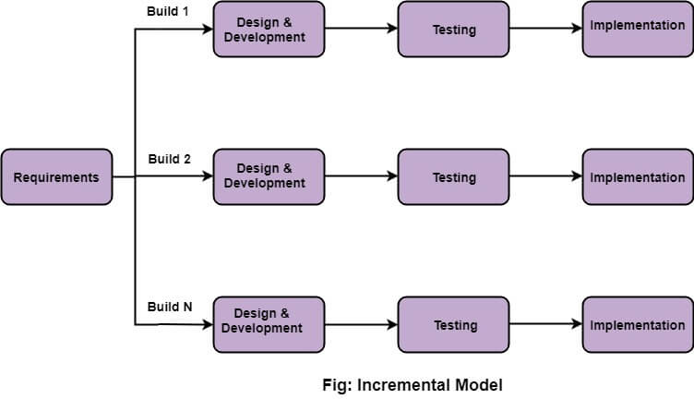
11
Design and Development Methodology
Incremental model:
We will be following incremental methodology for the development of our project.
Figure 1 user use case diagram

Slide 12
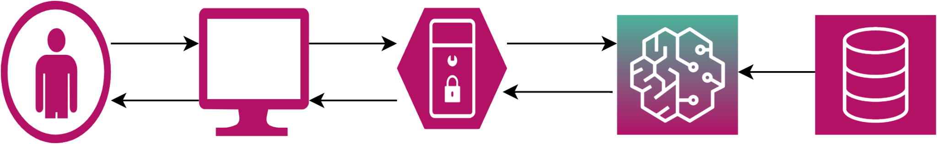
12
Design and Development Methodology
High Level Architecture Diagram:

Slide 13
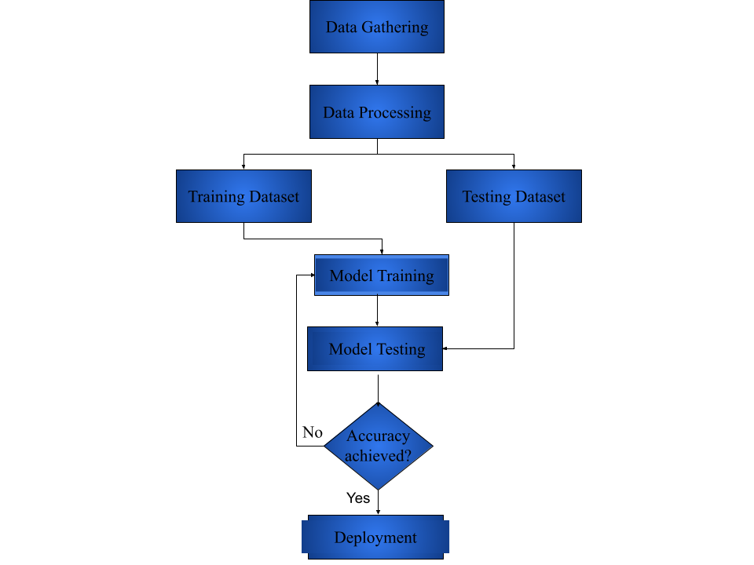
13
Design and Development Methodology Continued!
Machine learning process model:

Slide 14
14
References
https://bakhabarkissan.com/
https://aari.punjab.gov.pk/
https://agri.sindh.gov.pk/
CropPedia: A crop encyclopedia (last year’s project)
https://www.interviewbit.com/blog/incremental-model/

Slide 15
15
Thank you!

